Slide 2
Moon Walking With JavaScript
By Markandey Singh

Slide 3
Hello

Slide 4
I am markandey

Slide 5
I work at Yahoo! YDN more precisely
Notes:
I work at Yahoo!!, More precisely at Yahoo Developer Network.

Slide 6
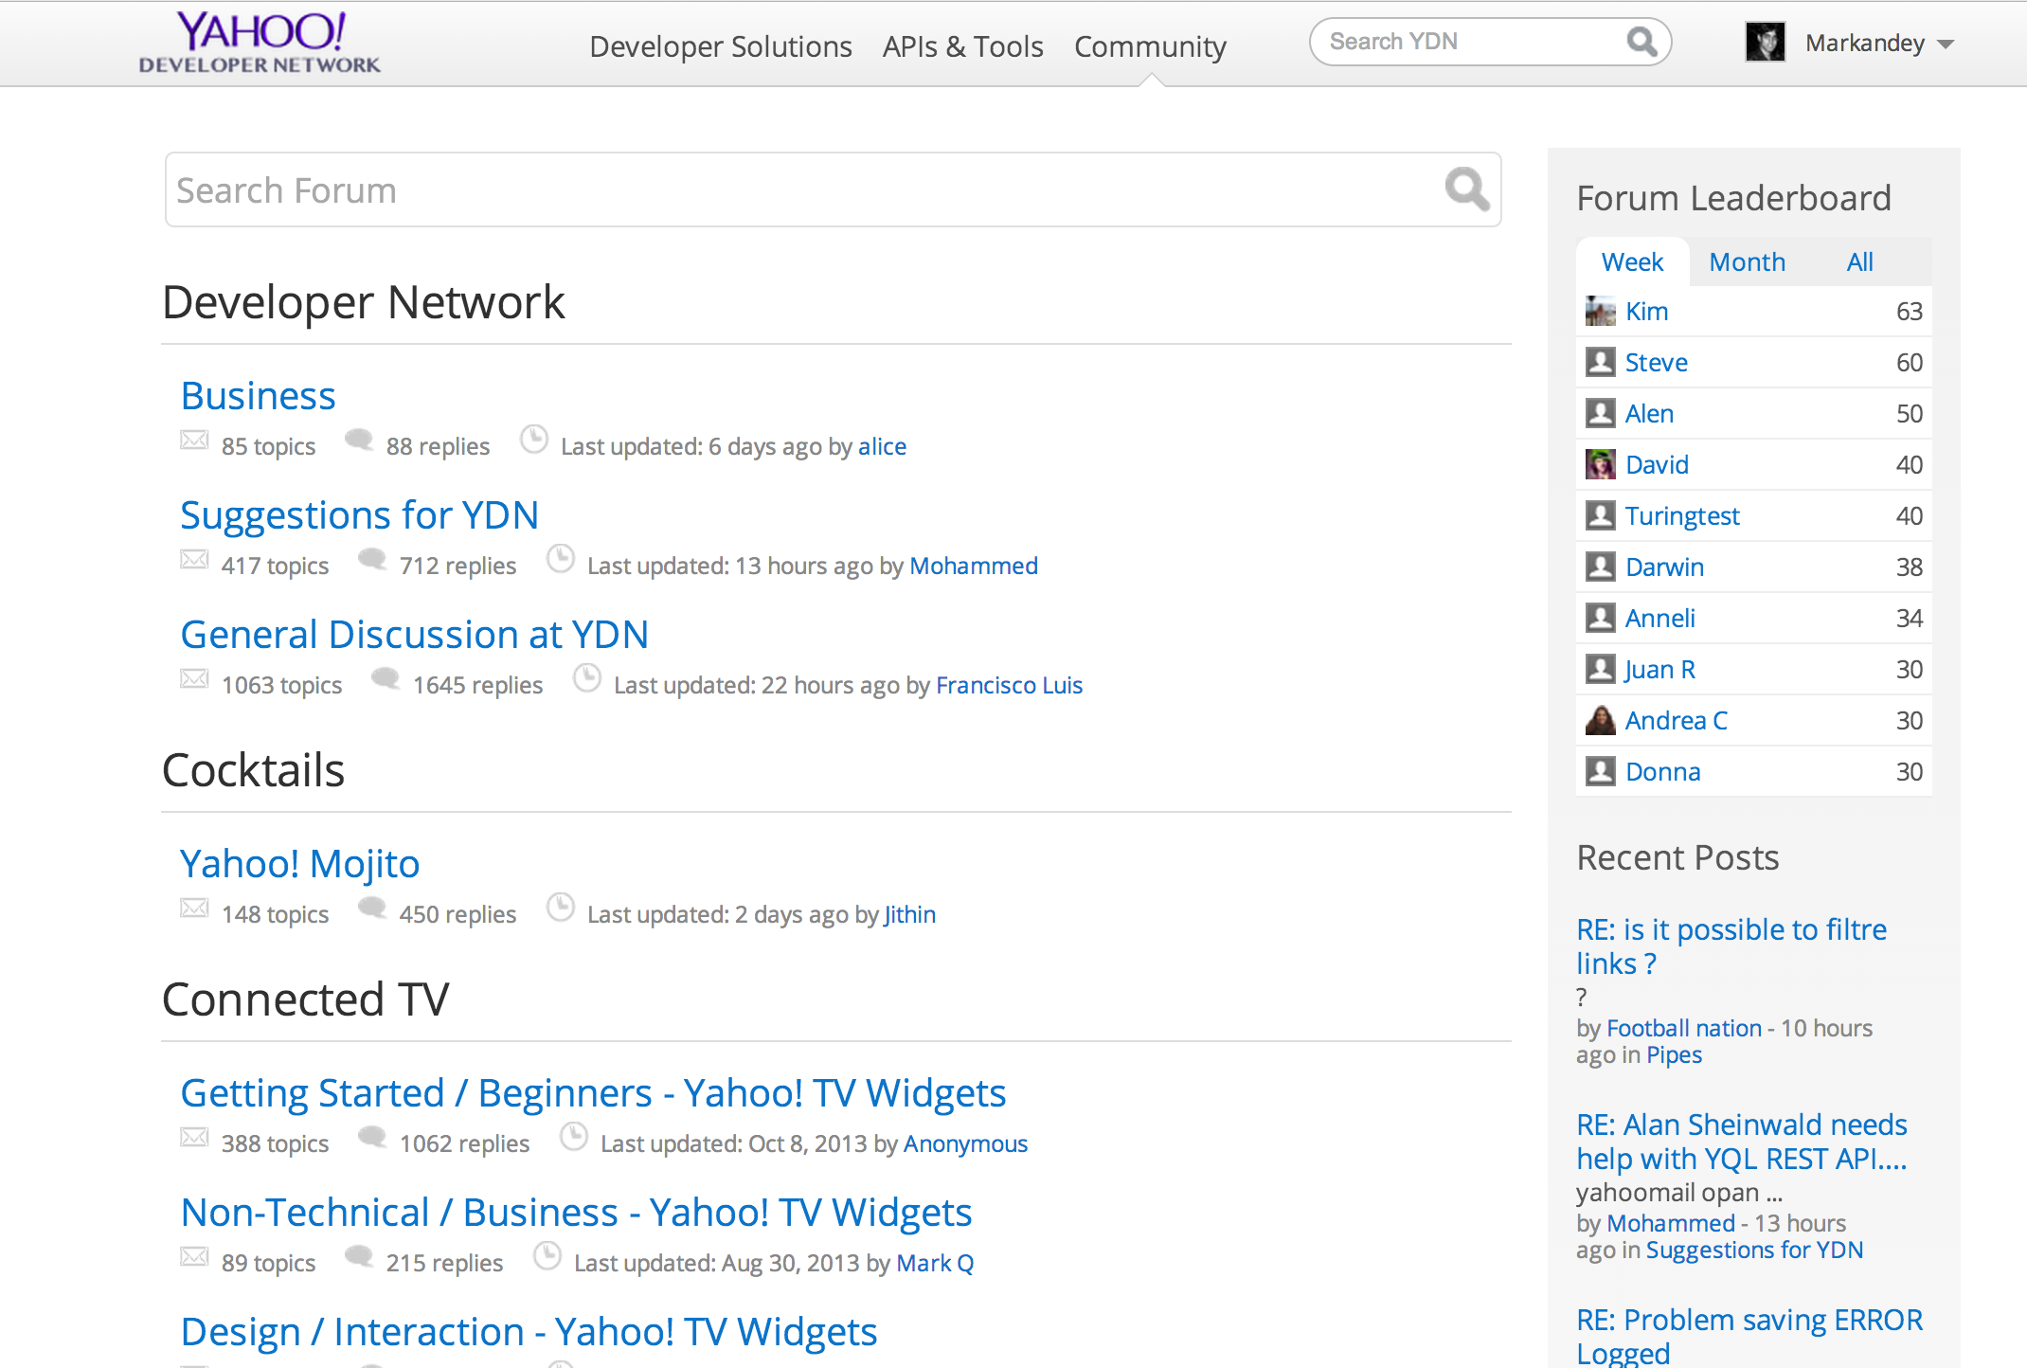
I have a very short talk about my experience while developing http://developer.yahoo.com/forum/
Notes:
I work at Yahoo!!, More precisely at Yahoo Developer Network.

Slide 7
BACK END API
SERVER SIDE FRONTEND
CLIENT SIDE

Slide 8
3 Layer for a web in general
BACK END API
SERVER SIDE FRONTEND
CLIENT SIDE

Slide 9
As a front end engineer we control only 2 things
BACK END API
SERVER SIDE FRONTEND
CLIENT SIDE

Slide 10
backend guys, optimize to respond in ms.
BACK END API
(ms)
SERVER SIDE FRONTEND
CLIENT SIDE

Slide 11
Front end engineering is different
BACK END API
SERVER SIDE FRONTEND
CLIENT SIDE

Slide 12
It has human involved
BACK END API
SERVER SIDE FRONTEND
CLIENT SIDE

Slide 13
0.1s
1s
10s
Less than 100ms is instantaneous
Notes:
Add real gif here

Slide 14
0.1s
1s
10s
More than 100ms , user will notice a delay

Slide 15
0.1s
1s
10s
More than 100ms , user will notice a delay

Slide 16
0.1s
1s
10s
In 10s user will switch the tab and start doing something else

Slide 17
Sometime, time is not even important. how you do it matters!

Slide 18
e.g., if your site takes more time with less browser reflows, feels better than my site which takes less time with more browser reflows.

Slide 19
e.g., if your site takes more time with less browser reflows, feels better than my site which takes less time with more browser reflows.

Slide 20
e.g., if your site takes more time with less browser reflows, feels better than my site which takes less time with more browser reflows.

Slide 21
e.g., if your site takes more time with less browser reflows, feels better than my site which takes less time with more browser reflows.

Slide 22
e.g., if your site takes more time with less browser reflows, feels better than my site which takes less time with more browser reflows.

Slide 23


What User Perceives as slow
Time To First Byte
Time To API Response

Slide 24
Time to first Byte is
DNS Lookup
Initial Connection
Waiting
Receiving Data
Closing Connection

Slide 25
Time to first Byte is
DNS Lookup
Initial Connection
Waiting
Receiving Data
Closing Connection
There is a problem here

Slide 26
Where are we? (these things are done!)
Minify js
Inject script blocks to load in parallel.
JavaScript at the bottom.
Minify css
….
CDN
Yslow!

Slide 27
Now what!

Slide 28
Header
Main
Side
Footer

Slide 29
Header
(50ms)
Main
(300ms)
Side
(300ms)
Footer
(50ms)

Slide 30
Header
(50ms)
Main
(300ms)
Side
(300ms)
700ms
Footer
(50ms)

Slide 31
Header
Main
Side
Footer

Slide 32

Header
Main
Footer

Slide 33
Header
Main
You see this until DOM loads and API
returns data
Footer

Slide 34

Work With an Example
YQL/FLICKR API

Slide 35
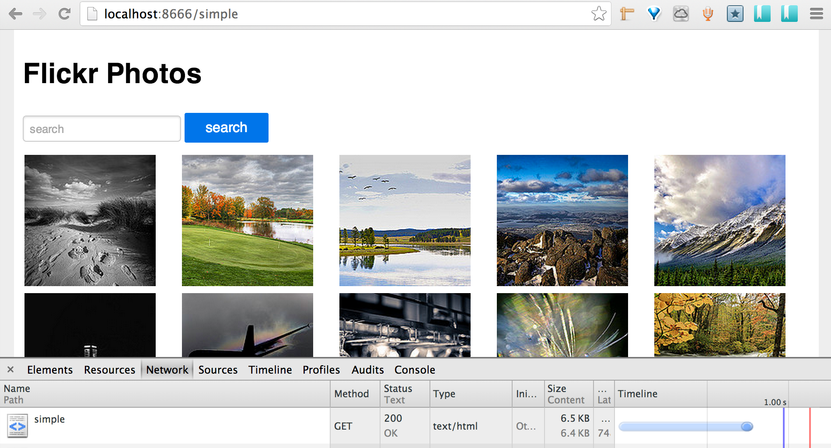
Simple implementation takes
First Byte
748ms

Slide 36
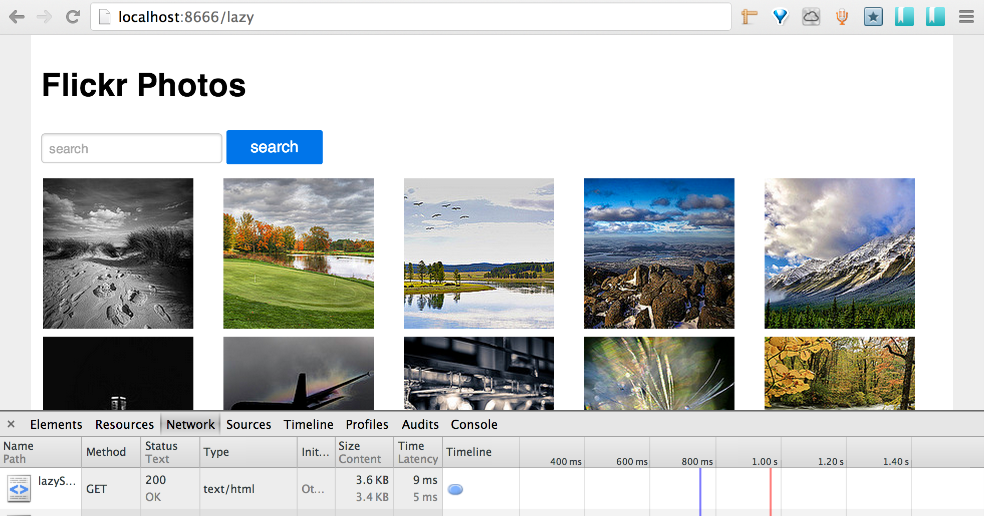
Lazy implementation takes
First Byte
5ms
After 400ms later triggers the YQL Call which takes
430ms.
Total 835s

Slide 37
Simple 738 ms
Conclusion
Lazy 835 ms

Slide 38
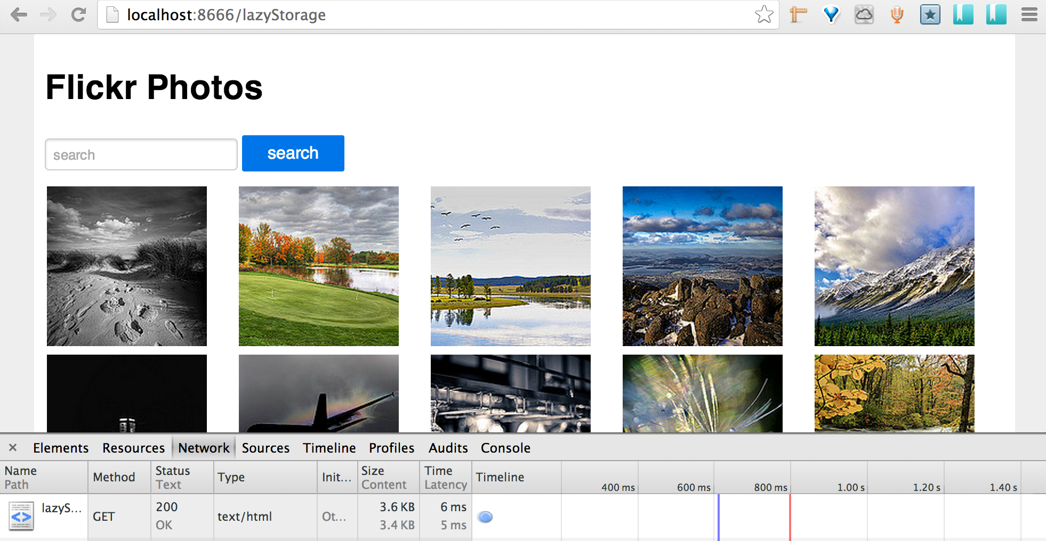
Lets move to 3rd implementation
Lazy + a local storage cache

Slide 39
Simple 738 ms
Lazy 835 ms
Conclusion
Lazy with storage 450ms

Slide 40
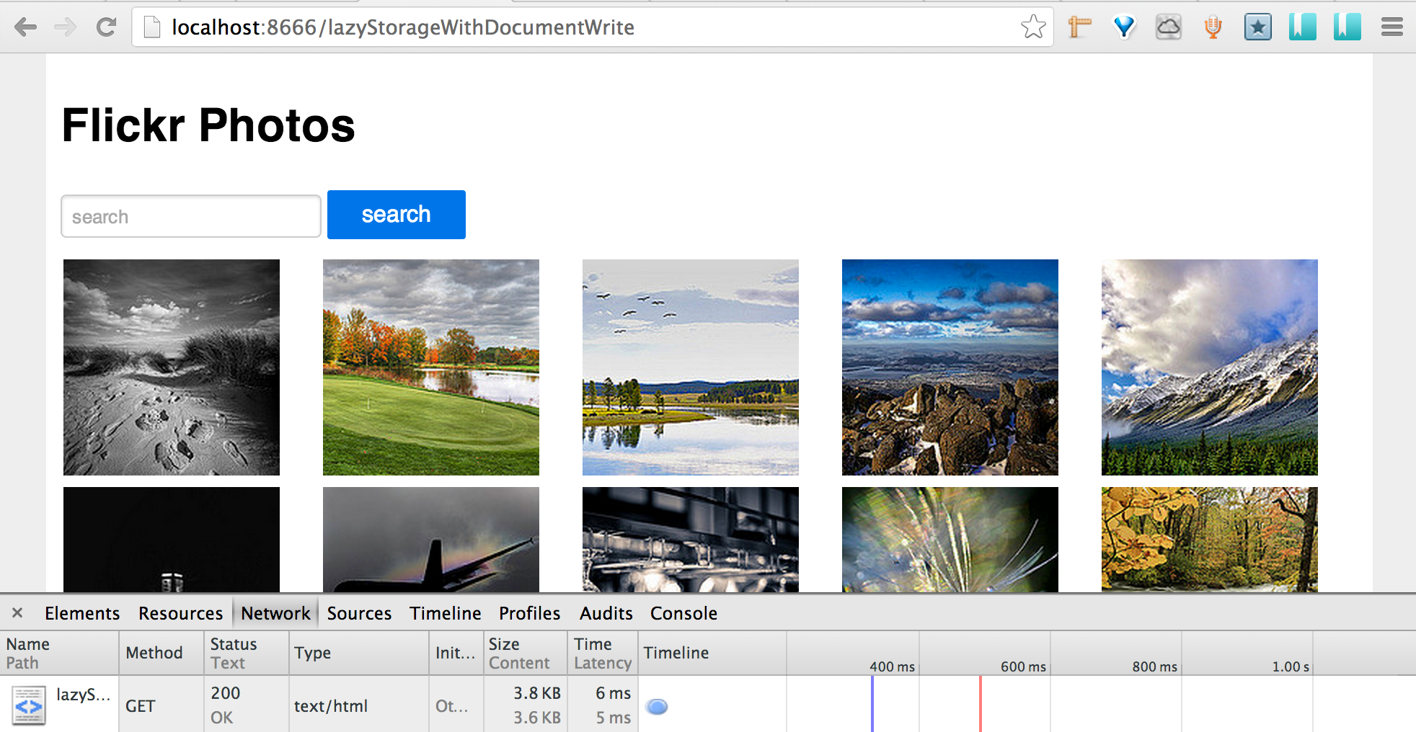
Lets move to 3rd implementation
Lazy + a local storage cache +

Slide 41
Lets move to 3rd implementation
Lazy + a local storage cache +
Document.write

Slide 42
Document.write

Slide 43
<script> (function(){ var a=window.localStorage;a&&((a=a.getItem("what-item"))?document.write(a):document.write("Loading.."))} )(); </script>

Slide 44
Simple 738 ms
Lazy 835 ms
Conclusion
Lazy with storage 450ms
6ms
Lazy with storage with document. write

Slide 45



FLICKR
YQL

Slide 46
Header
Main
Side
Side appears instantaneously
Footer

Slide 47
Use local storage to reduce user frustration!

Slide 48
Pinterest Magic

Slide 49
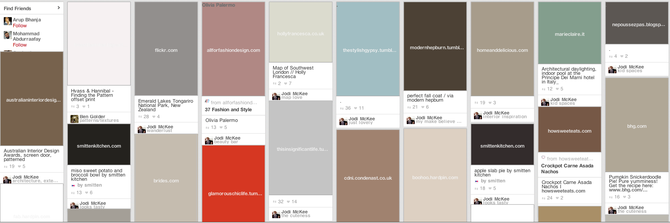

Slide 50


Slide 51
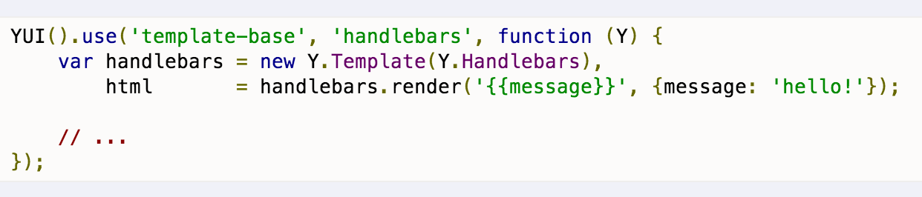
YUI Options Y.Substitute Y.Lang.sub Y.Template
Use Client side templating
JSON < HTML

Slide 52
Use Client Side Templating
JSON < HTML
HPACK<CJSON < JSON
http://bit.ly/hpack

Slide 53
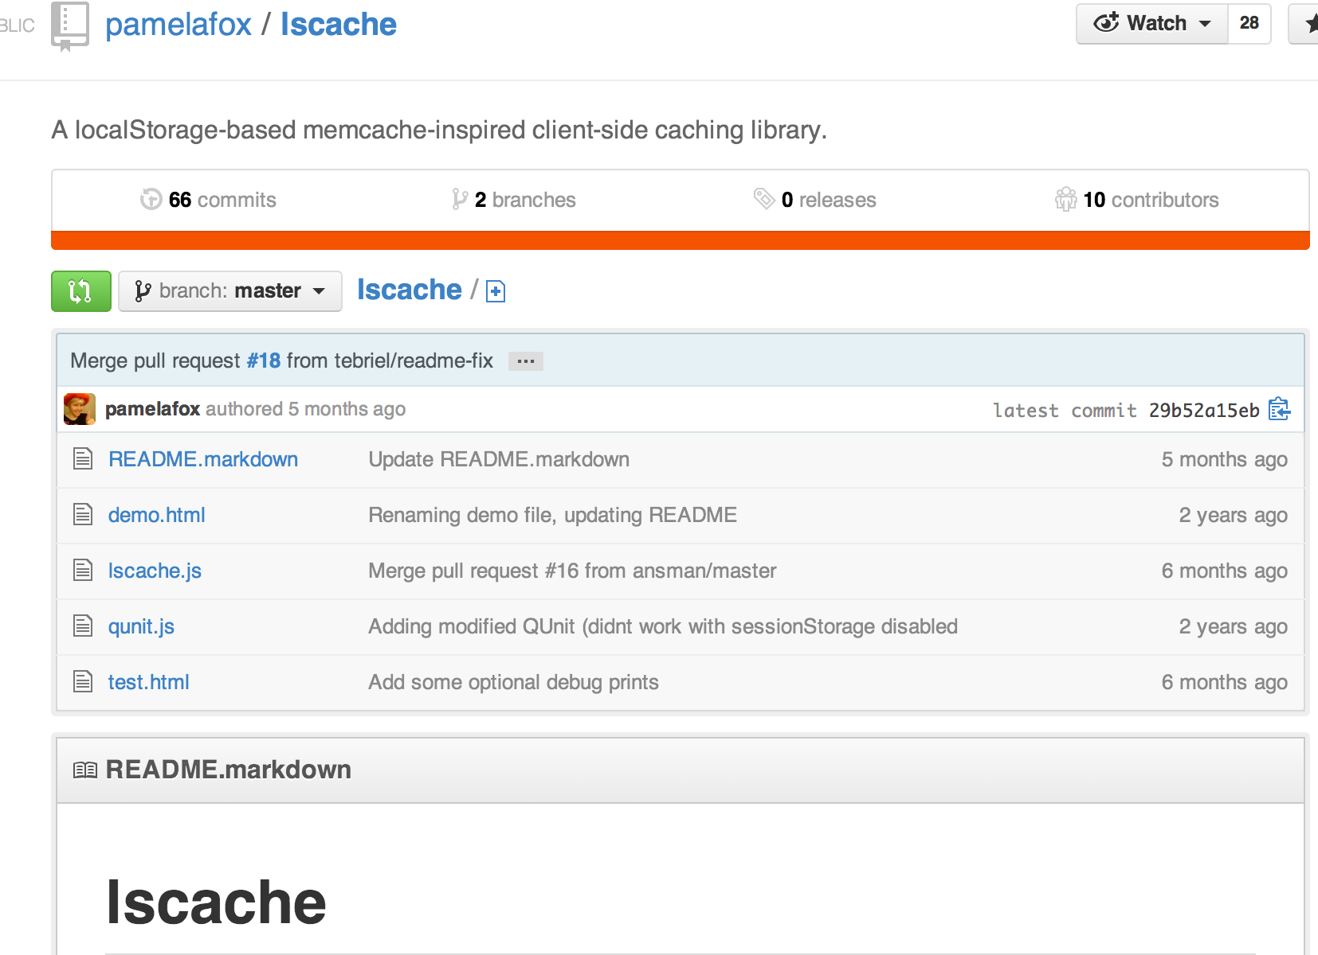
Local storage as client side memcache

Slide 54
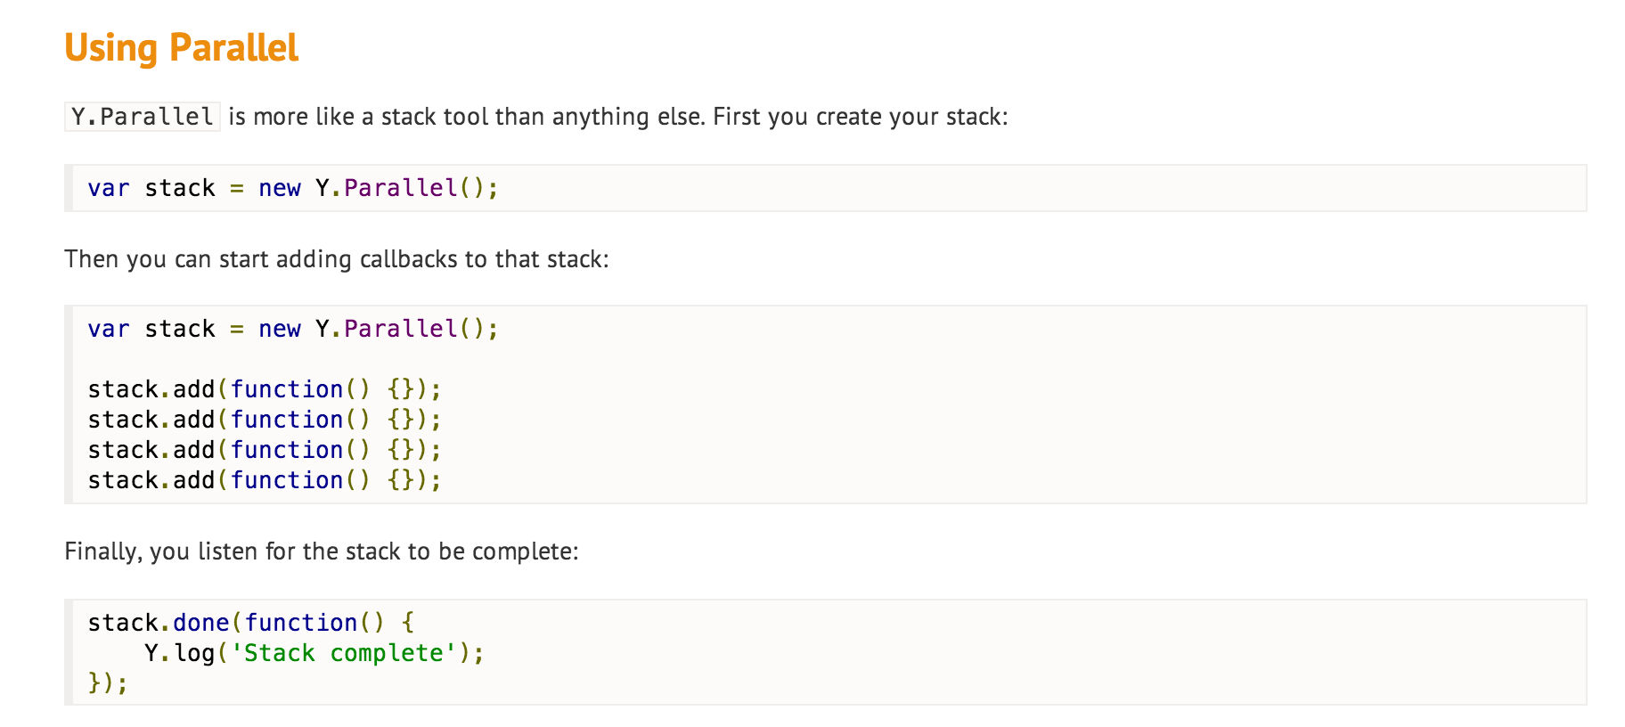
Use Parralel I/Os to to speed up data pull!
http://bit.ly/everythingatoncejs

Slide 55
Demo

Slide 56
Load Stuff on view
http://bit.ly/gallery-inview

